Slide 1
.NET
Beginner Level

Slide 2

Overview
Information about Course
Course Overview
Prerequisite knowledge
Overview per weeks
Development tools
Components
Learning Resources
Learning outcomes
Intro to .NET

Slide 3
Course Info
5 weeks
Tuesday & Thursday 18:00 – 20:00
First 2 weeks, only on Tuesday 18:00 – 20:00

Slide 4
Prerequisite knowledge
Basics of SQL & Database Management
C# Basics
OOP
Inheritance
Interface
Dependency Injection
GIT

Slide 5
Course Overview
Week 1 :: Introduction
Introduction to .NET and Environment Setup
Introduction to ASP.NET Core MVC
MVC Basics
Week 2 :: Building Employee Manager
Data Management with .NET (EF Core)
Testing & Debugging
Building First CRUD

Slide 6
Course Overview
Week 3 :: Building Employee Manager
Data Management with .NET (EF Core)
Forms & Validation
CRUD
Week 4 :: Building Employee Manager
Data Management with .NET (EF Core)
Authentication and Authorization
CRUD
Week 5 :: Deployment & Best Practices

Slide 7
Course Components
Lectures
Core concepts explained with slides and live coding
Labs
Hands-on sessions where students work on tasks or projects under guidance
Homework Assignments
Tasks assigned for practice at home to reinforce learning

Slide 8
Course Components
Project
A course-end project that encapsulates all the learning objectives, where students develop a full-fledged .NET application
2 – 3 week to develop application and post it on GitHub and send email
Quizzes
Short quizzes to assess understanding of the key concept
Feedback Sessions
Regular feedback sessions to address student queries and gauge course effectiveness

Slide 9
Development Tools
.NET SDK & Runtime Environment
IDE
SQL Server
Database Management Tool
Browser (Chrome, Edge, …)
GIT Bash or GIT Extension integrated in IDE

Slide 10
Development Tools
Visual Studio (Visual Studio: IDE and Code Editor for Software Developers and Teams (microsoft.com))
Free for personal use
Paid for commercial use
Rider (Rider: The Cross-Platform .NET IDE from JetBrains)
Paid
Free version for student & open source contributors

Slide 11
Development Tools
MS SQL Server (SQL Server Downloads | Microsoft)
Docker Version
Docker desktop
SQL Server Docker Image (microsoft-mssql-server - Official Image | Docker Hub)

Slide 12
Development Tools
Azure Data Studio (Download and install Azure Data Studio - Azure Data Studio | Microsoft Learn)
Free
Based on VS Code
Any database
MSSQL Management Studio (Download SQL Server Management Studio (SSMS) - SQL Server Management Studio (SSMS) | Microsoft Learn)
Free
Only MSSQL Database
DataGrip (DataGrip: The Cross-Platform IDE for Databases & SQL by JetBrains)
Paid
Any database
IntelliSense

Slide 13
Learning Resources
GitHub
MSDN Documentation (Overview of ASP.NET Core | Microsoft Learn)
ChatGPT (ChatGPT (openai.com))
YouTube

Slide 14
Project Overview
Employee Management System backed by MSSQL database
Employees
Departments
Positions
CRUD operations on the related entities

Slide 15
Learning outcomes
Understand the .NET ecosystem and choose the right .NET technology for their projects
Build software products using .NET independently
Develop applications using C#, leveraging .NET
Deploy .NET applications to various platforms

Slide 16
.NET
Introduction

Slide 17
.NET Overview
What is .NET
Why .NET
History of .NET
Real World Scenarios
Components
.NET Web Development (ASP.NET MVC)
My First .NET App

Slide 18
.NET
.NET is a software framework developed by Microsoft
Used for building enterprise applications
It is used for building application like web, AI, IoT, ….
Supports multiple programming languages, libraries, and tools for developers to create, deploy, and manage applications

Slide 19
Why Choose .NET?
Cross-Platform Compatibility
High Performance
Robust Security Features
Rich Development Tools and IDEs
Vibrant Community and Corporate Support
Open Source and Collaborative Development
Comprehensive Documentation and Learning Resources

Slide 20
History of .NET
2002: .NET Framework 1.0 Released
Introduction of the .NET Framework by Microsoft
Aimed to support the development of applications across Windows platforms
Included features like ASP.NET WebForms, ADO.NET, and Windows Forms
2007: .NET Framework 3.0 and WPF
Introduction of Windows Presentation Foundation (WPF) for desktop applications
Addition of Windows Communication Foundation (WCF) and Windows Workflow Foundation (WF)

Slide 21
History of .NET
2016: Introduction of .NET Core
.NET Core launched as a cross-platform, open-source framework
Focused on cloud, web, and IoT applications
Support for Windows, Linux, and macOS platforms
2020: .NET 5.0 - The Unified Platform
Unification of .NET Core and .NET Framework into a single platform called .NET 5
Aimed to support all types of .NET applications under a single runtime and framework

Slide 22
History of .NET
2021 and Beyond: .NET 6, .NET 7, and the Future
Continued enhancements with .NET 6, .NET 7, .NET 8, focusing on performance, productivity, and platform compatibility
Introduction of MAUI for cross-platform GUI applications
Commitment to a yearly release cycle, ensuring continuous improvement and innovation

Slide 23
Read World Scenarios
Microsoft
Azure
Teams
Stack Overflow
Stack Overflow serves millions of developers worldwide, demonstrating .NET's ability to handle massive, dynamic user-generated content with ease
BMW
Deployed .NET in its production facilities for managing machinery and integrating IoT devices
UPS
Implemented .NET to enhance its logistics, tracking systems, and customer interface. The choice highlights .NET's reliability and ability to process large volumes of data in real-time.

Slide 24


Slide 25
Components of .NET
.NET Runtime
Executes applications and provides services such as memory management, type safety, exception handling, garbage collection, and more
NET SDK
A set of libraries and tools that allow developers to create .NET applications and services
Programming Languages
Primarily C#, F#, and Visual Basic, enabling developers to use a language that best suits their application or preference
ASP.NET
A subset of .NET designed for building web applications, offering tools and libraries specifically for web development

Slide 26
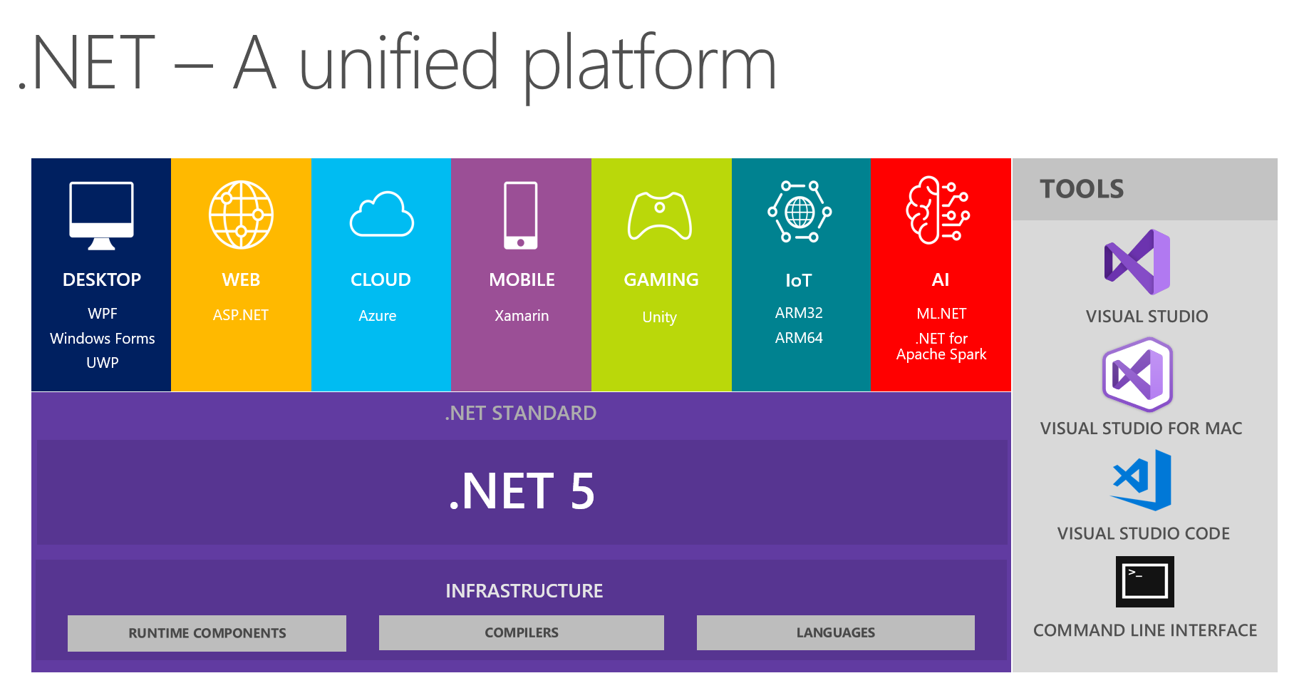

Slide 27

.NET Project Types
Console Applications
Web Applications
ASP.NET Core MVC
ASP.NET Core Web API
Blazor App
Desktop Applications
Cloud Applications
Azure Function
Internet of Things (IoT)
Game Development
Unity
Machine Learning and AI

Slide 28
ASP.NET
ASP.NET Core is an open-source, server-side web application framework designed for web development to produce dynamic web pages and applications
Project Types
MVC
Razor Pages
Web API

Slide 29
MVC Architecture
Model
Represents the data and business logic of the application. It is responsible for accessing data from databases, processing it, and defining the rules for how data can be changed and manipulated
View
Represents the UI components of the application. It displays the model data to the user and sends user commands to the controller. The view is responsible for the look and feel of the application
Controller
Acts as an intermediary between the model and the view. It listens to user input triggered through the view, processes it (with possible changes to the model), and returns the output display to the view

Slide 30
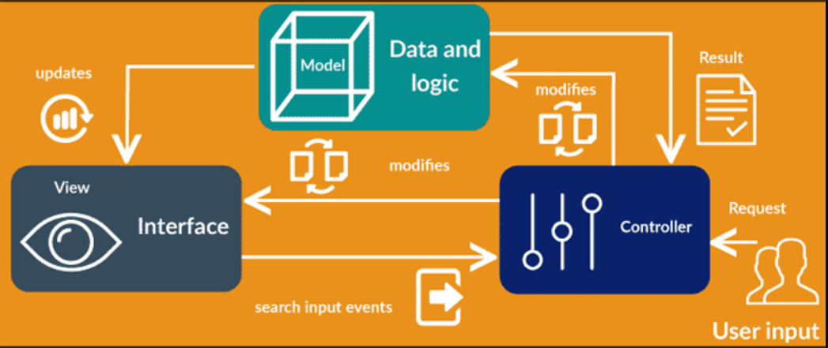

Slide 31
Key Components
Startup Class
Middleware
Dependency Injection (DI) Container
Routing
Controllers and Actions
Models
Views

Slide 32
Startup Class
From Version .NET 6 everything is in Program.cs
Service Configuration

Slide 33
Middleware
Middleware is used for logging, authentication, serving static files, error handling, and much more
You can create custom middleware for specific tasks that are not covered by built-in middleware

Slide 34
Routing
Conventional Routing
{controller=Home}/{action=Index}/{id?}
Attribute Routing

Slide 35
Controllers
Class that handles incoming web requests
Processing input from the user, via URL parameters, query strings, or form values

Slide 36
Actions
Action methods are just C# methods in a controller class that have been exposed as actions
They can return various action results, including HTML (ViewResult), data (JsonResult)
Actions can be decorated with attributes to specify HTTP methods they respond to, such as ‘HTTPGET’, ‘HTTPPOST’, ‘HTTPPUT’, ‘HTTPDELETE’

Slide 37
Models
Data Representation
Business Logic
Validation
Data Access

Slide 38
Views
Razor Syntax
Layouts
ViewBag
ViewData
TagHelpers

Slide 39

My First .NET App

Slide 40

Q&A

Slide 41

Thank You !!!

